Slide 1
论文分享: Patch Attack 论文串讲
1. On Physical Adversarial Patches for Object Detection, 2019
2. Suppress with a Patch: Revisiting Universal Adversarial Patch Attacks against Object Detection, 2022

Slide 2
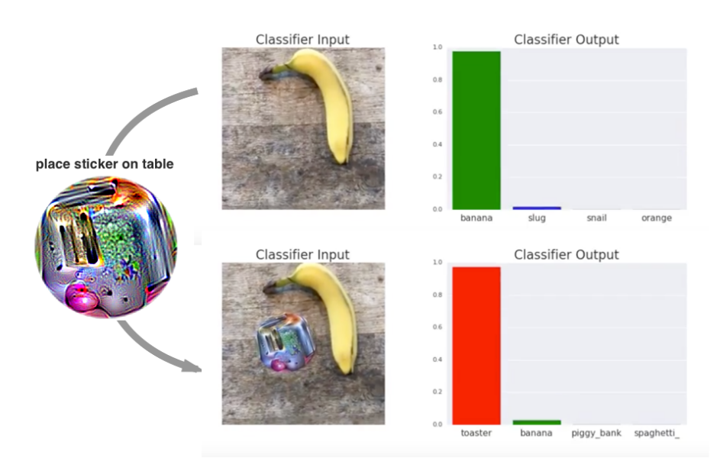
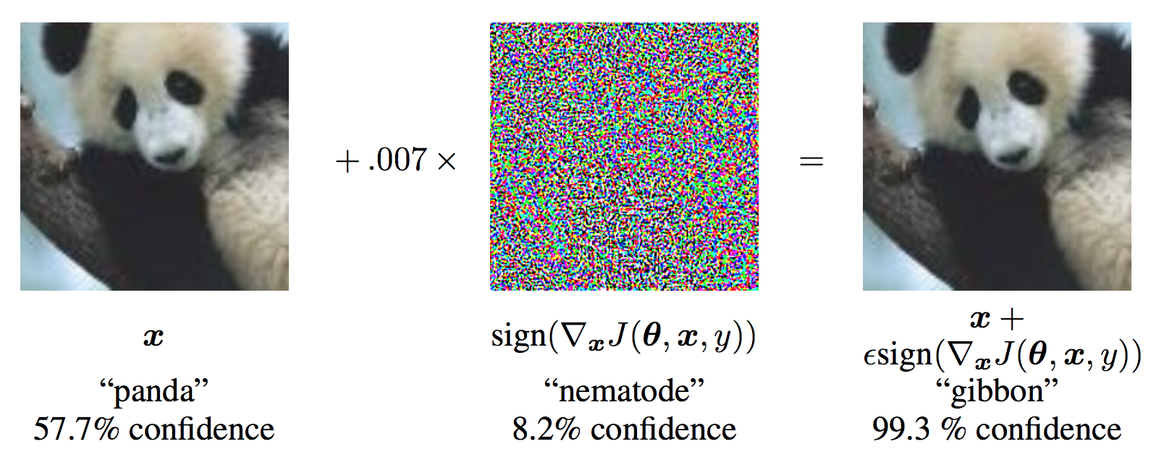
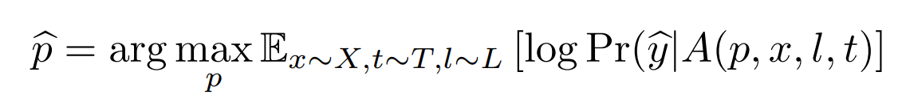
1. Problem Setting
Previous work: Adversarial attack by adding invisible noise-like adversarial samples.
Problem: Infeasible in physical-world
objective function to optimize:

Slide 3
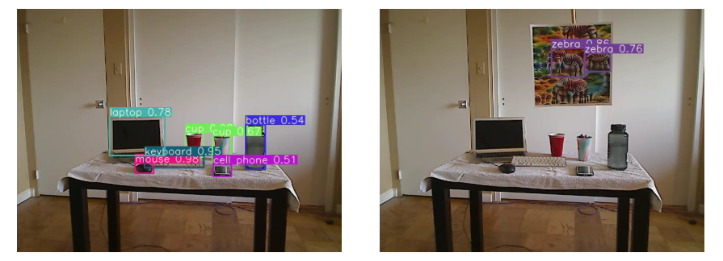
2. Challenges
i. Object Detection vs. Classification: More complicated model
ii. Physical-world feasibility
iii. Universal Patch
iv. Global Attack: Single patch suppress all detection.

Slide 4

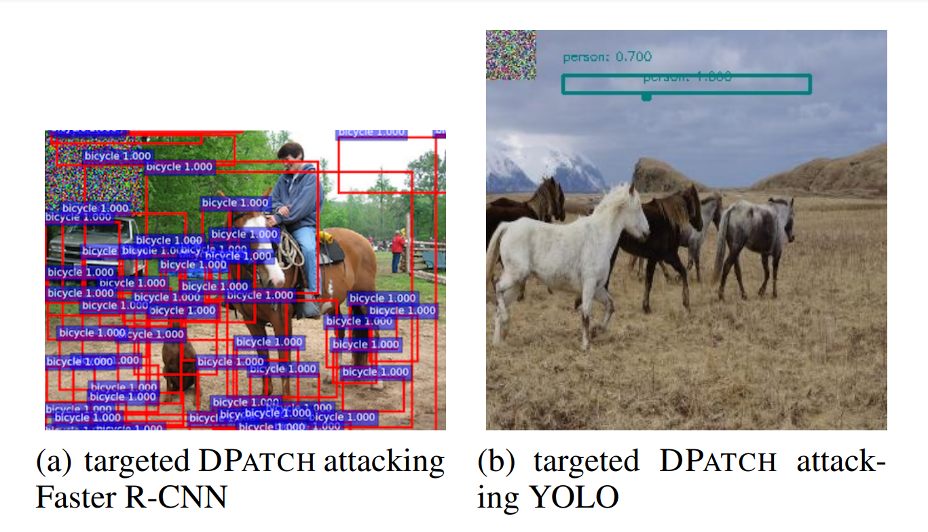
3. Related Work
DPATCH: An Adversarial Patch Attack on Object Detectors

Slide 5
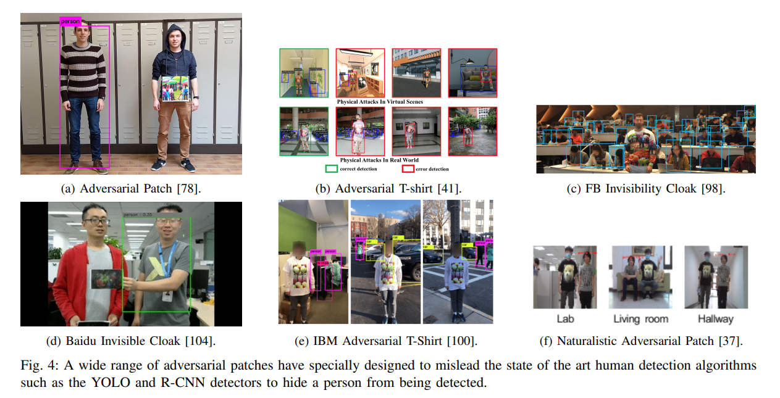

Slide 6
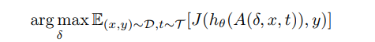
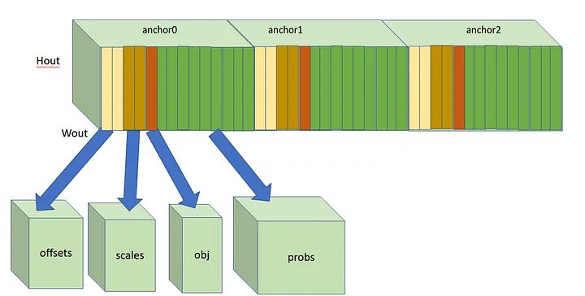
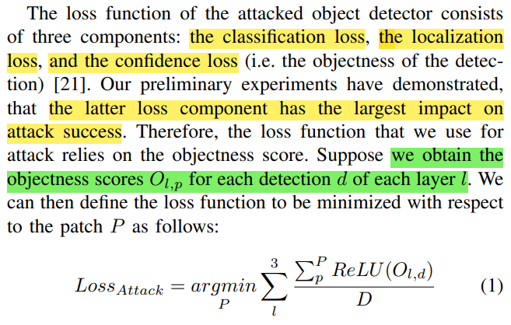
4. Method
Attack formulation:
EOT
YOLOv3 outputs(COCO) → List[Tensor]
[[batch, channel, h0, w0, 85], [.., h1, w1, ..], [.., h2, w2, ..]]
[cx, cy, h, w, Obj, …]

Slide 7
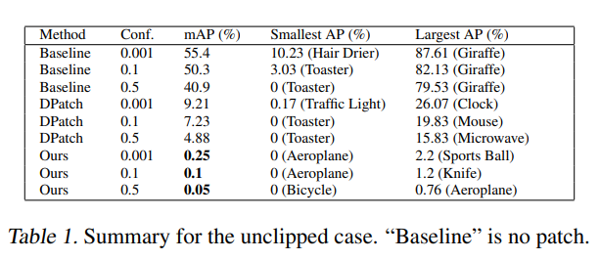
5. Experiment
Metric: mAP, ASR
Physical-world test：demo video
5. Future work
Improve Patch Generation.
Improve Training Efficiency.
Improve Robustness.
Apply to Traffic Scenario.

Slide 8
谢谢！

